Slide 1
Actionable Business Recommendations for Reducing Churn in Telecom
Based on the Analysis and Model Prediction Used

Slide 2
Business Problem & Importance
- High customer churn leads to revenue loss.
- Predictive analytics can proactively identify and retain at-risk customers.
- Implementing AI-driven strategies will increase retention and revenue.

Slide 3
Model Performance Insights
Class 1 (Loyal Customers)
- Precision: 0.87, Recall: 0.78, F1-score: 0.82
- Model accurately identifies them, unlikely to churn.
Class 2 (At-Risk Customers)
- Precision: 0.52, Recall: 0.67, F1-score: 0.59
- Model captures 67% of at-risk customers but includes false positives.

Slide 4
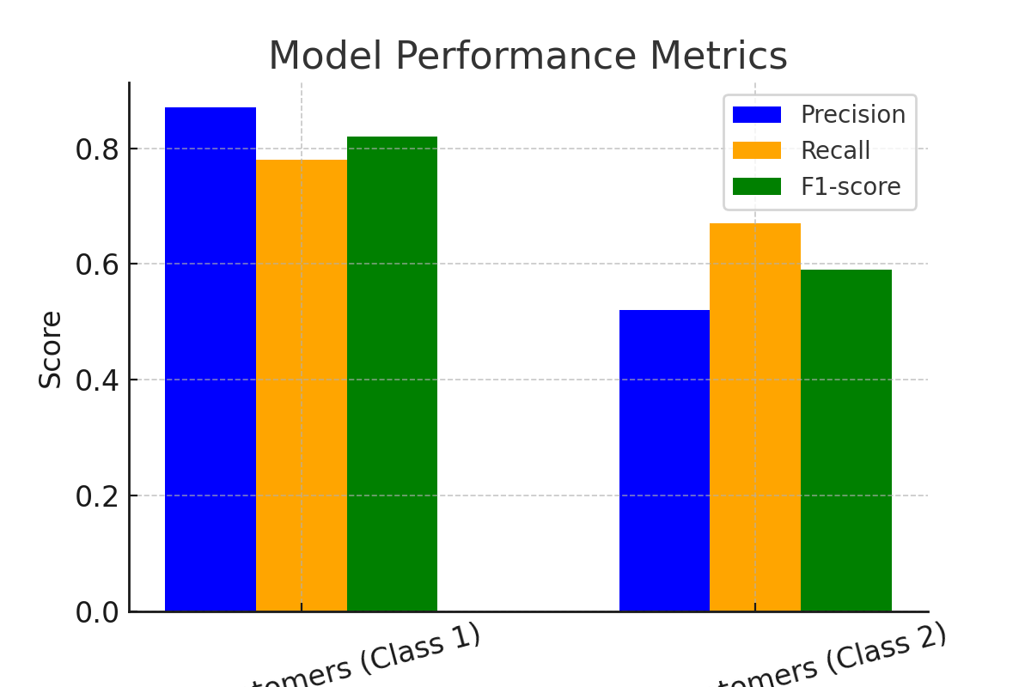
Model Performance Insights

Slide 5
Marketing Strategies to Reduce Churn
1. Personalized Retention Campaigns for At-Risk Customers
- Identify churn signals (drop in usage, late payments)
- Offer custom retention plans (discounted data, exclusive bundles)
- Expected Impact: 10-15% churn reduction
2. Target Loyal Customers for Upselling
- Recommend premium plans, upgrades

Slide 6
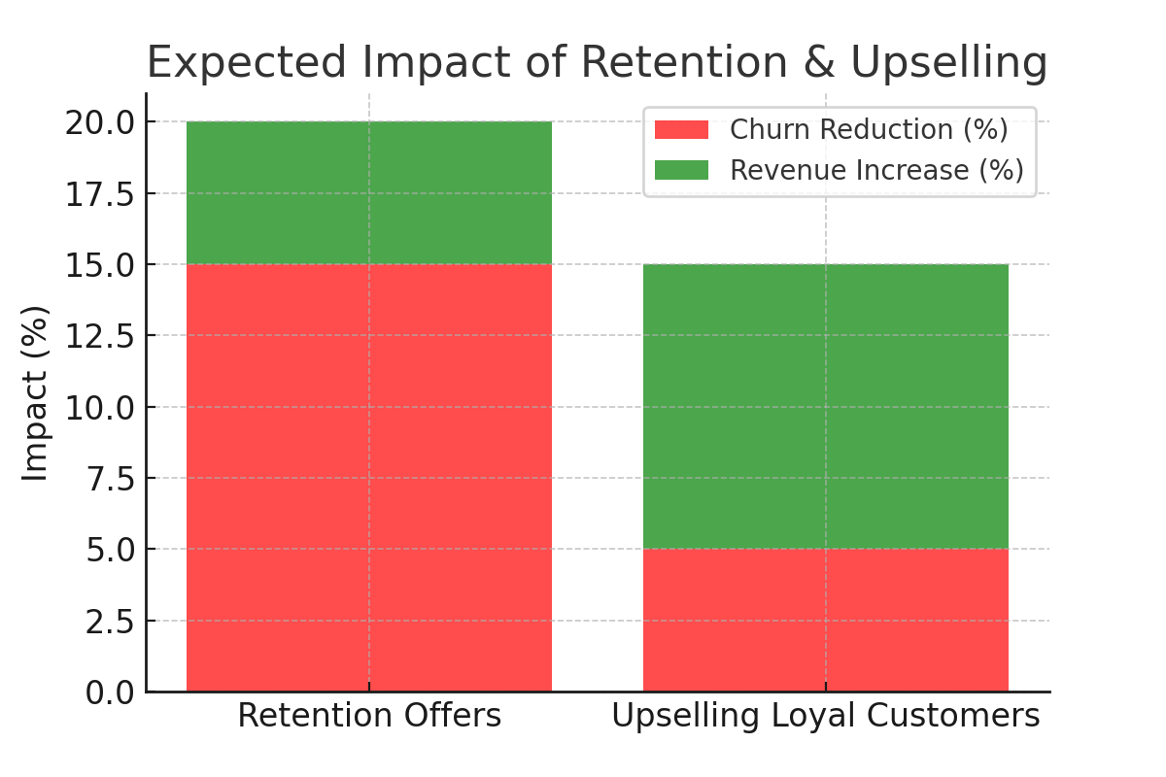
Expected Impact of Marketing Strategies

Slide 7
Retention Offers & Loyalty Programs
1. Win-Back Offers for Inactive Users
- Re-engage with time-sensitive discounts
- Example: 'Come back in 7 days & get 50% off your next recharge'
- Expected Impact: 5-8% churn reduction
2. Loyalty Programs for High-Value Customers
- Tiered Loyalty Program (Silver, Gold, Platinum)
- Exclusive perks: OTT subscriptions, priority support
- Expected Impact: 15-20% increase in CLV

Slide 8
Estimated Impact on Revenue & Churn
- Personalized Retention: 10-15% churn reduction
- Win-Back Offers: 5-8% churn reduction
- Loyalty Programs: 15-20% CLV increase
- AI-Powered Support: Higher NPS & retention
- Overall: Reduce churn by up to 15%, increase revenue by 10-20%

Slide 9
Expected Impact on Revenue & Churn Rate
Recommendation | Expected Impact on Revenue | Expected Impact on Churn Rate
Personalized marketing for Class 1 | +10-15% increase in repeat purchases | Slight decrease (already engaged customers)
Refined targeting for Class 2 | +5-8% increase in marketing efficiency | -5% churn reduction
Retention offers for loyal customers | +7-10% increase in lifetime value | -3% churn reduction
Win-back campaigns for Class 2 | +5% revenue from reactivated customers | -8-12% churn reduction
Automated early warning system | Indirect revenue boost from retention | -10-15% churn reduction

Slide 10
Customer Engagement Tactics
1. Early Warning System for Churn Detection
- Automate alerts for declining usage
- Trigger personalized engagement messages
- Expected Impact: 8-12% churn reduction
2. AI-Powered Customer Support
- Implement AI chatbots for instant troubleshooting
- Provide priority support for high-value customers
- Expected Impact: Improved satisfaction & lower churn

Slide 11
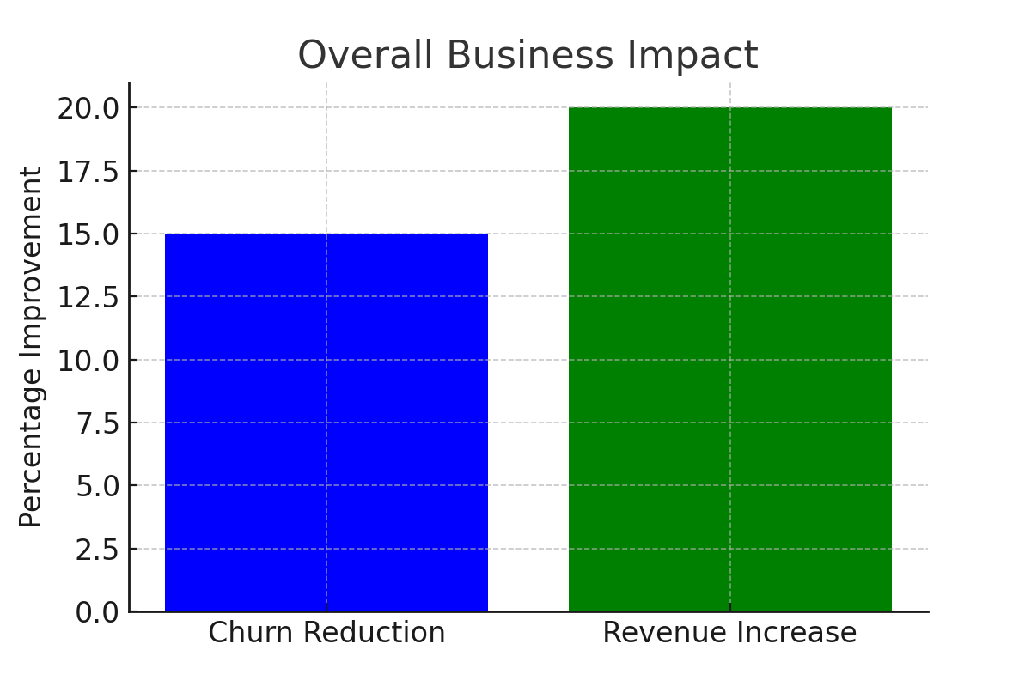
Overall Estimated Impact on Business

Slide 12
Final Summary and Next Steps
1. Use AI-driven marketing to target at-risk customers.
2. Implement a loyalty program for high-value customers.
3. Launch win-back campaigns for inactive users.
4. Deploy early warning systems to detect churn risks.
5. Improve customer support with AI chatbots.
By implementing these strategies, the company can reduce churn by up to 15% and increase revenue by 10-20%.

